Slide 1

Neural Networks
Venelin Valkov
Plovdiv University
2018

Slide 2
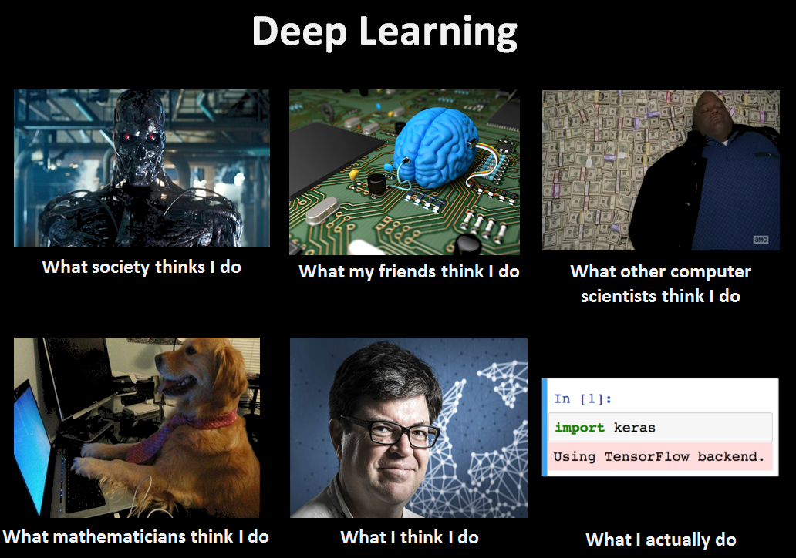

Slide 3
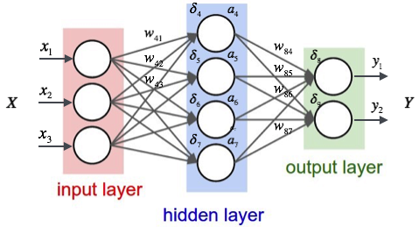

Slide 4
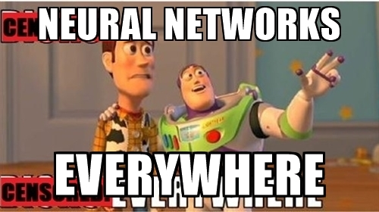

Slide 5
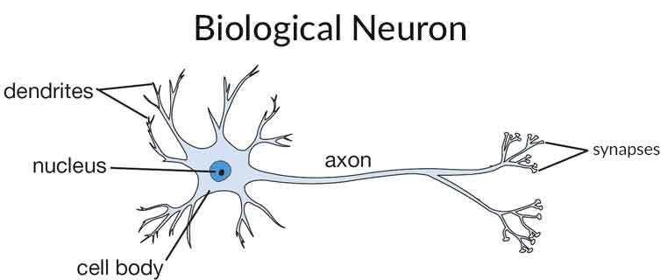
Inspiration?
Dendrite — It receives signals from other neurons.
Synapses - The point of interconnection of one neuron with other neurons. The amount of signal transmitted depend upon the strength (synaptic weights) of the connections.
Cell body - sums all incoming signals to generate input
Axon - when the sum reaches a threshold value, neuron fires and the signal travels to other neurons (via the axon)

Slide 6
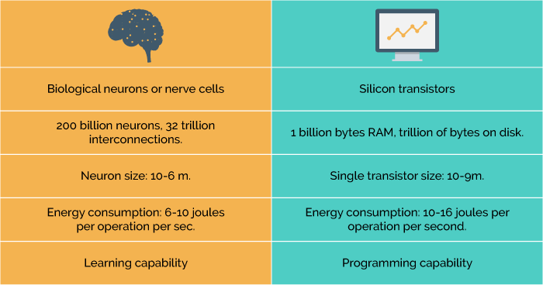
Your brain vs Computer

Slide 7
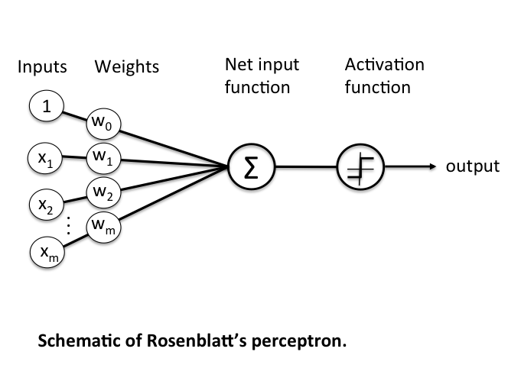
Perceptron

Slide 8
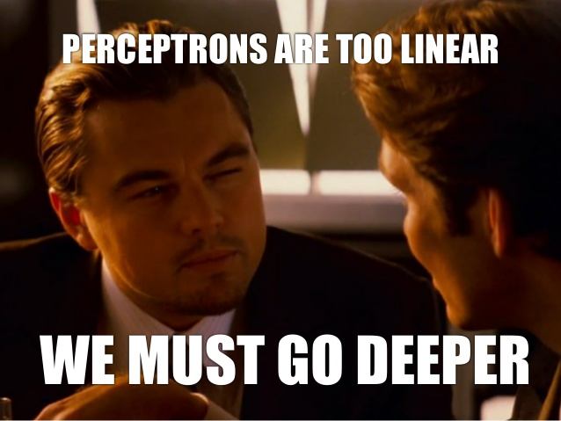
Deep Learning?

Slide 9
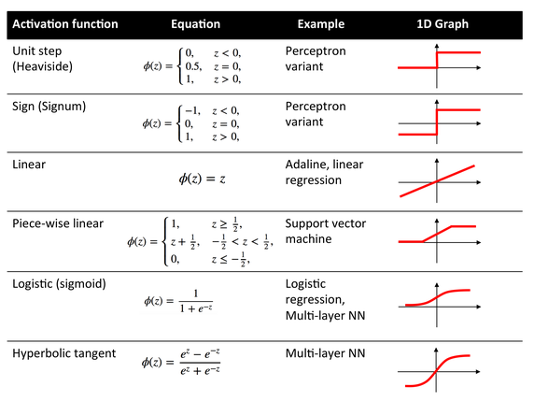

Slide 10
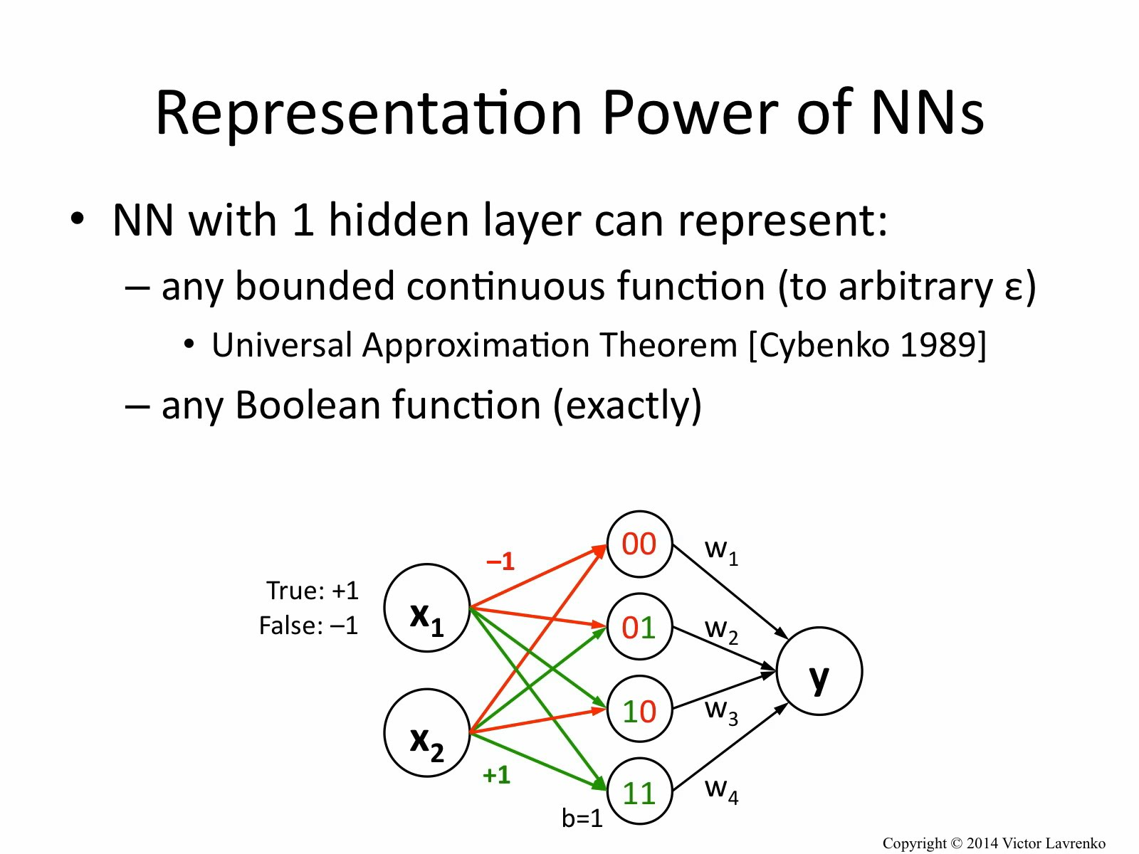

Slide 11
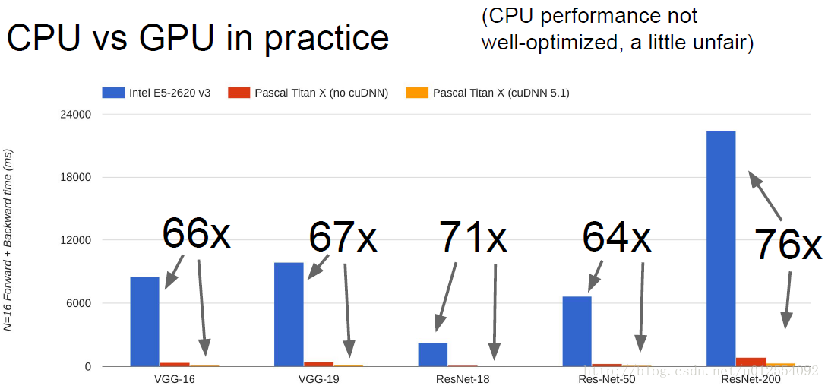

Slide 12


Slide 13
Building your own Deep Neural Network

Slide 14


Slide 15

ANN Architecture

Slide 16
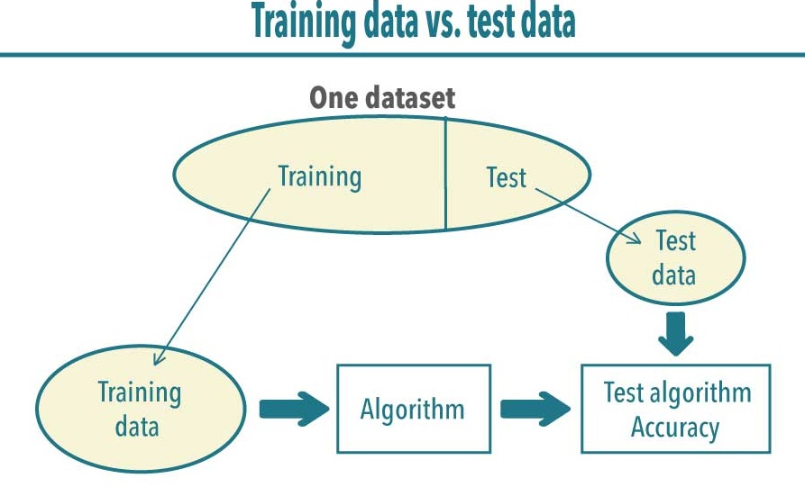

Slide 17


Slide 18
How do you train one?

Slide 19
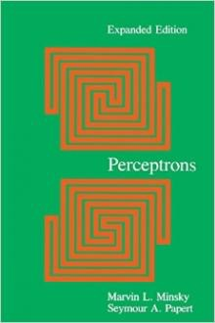
Perceptrons (1969)
by Marvin Minsky, founder of the MIT AI Lab
We need to use MLP, multilayer perceptrons (multilayer neural nets)
No one on earth had found a viable way to train MLPs good enough to learn such simple functions.

Slide 20
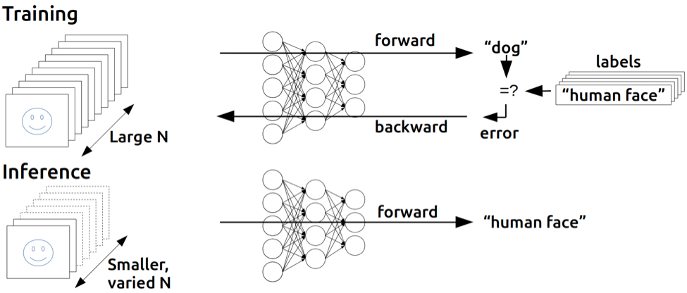
Backpropagation
(1974, 1982 by Paul Werbos, 1986 by Hinton)
https://devblogs.nvidia.com/parallelforall/inference-next-step-gpu-accelerated-deep-learning/

Slide 21
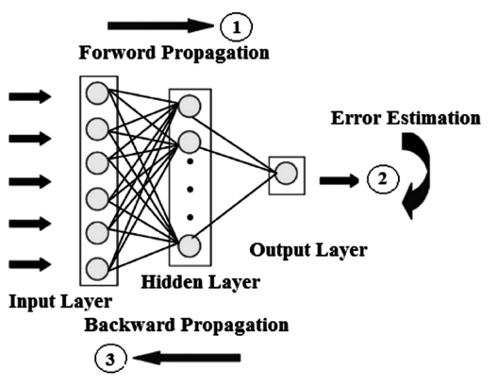

Slide 22
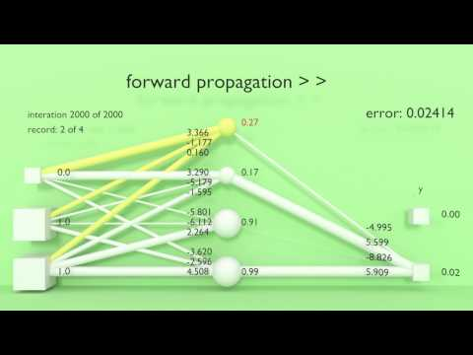

Slide 23
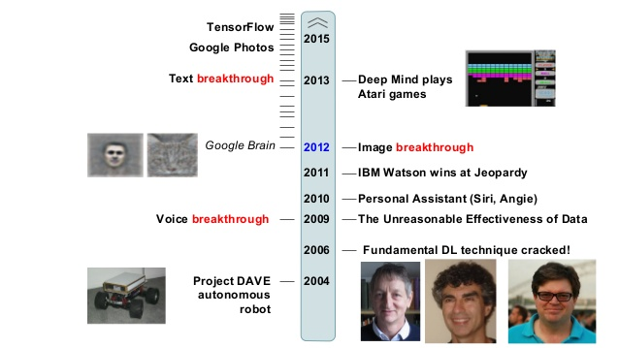
Progress

Slide 24
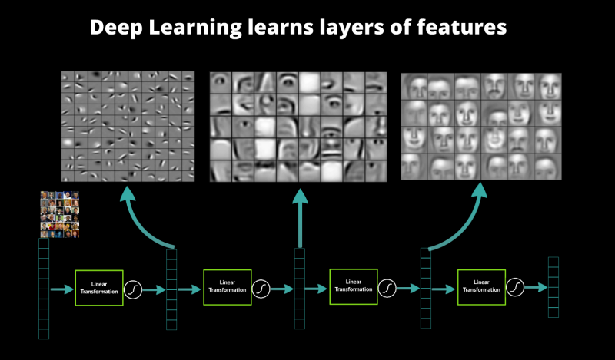

Slide 25
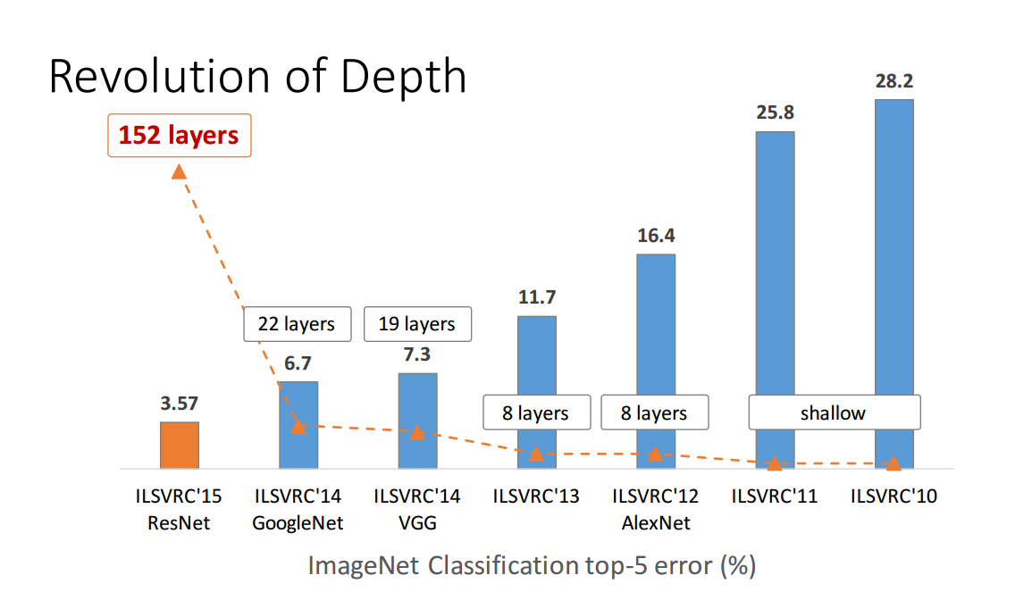

Slide 26
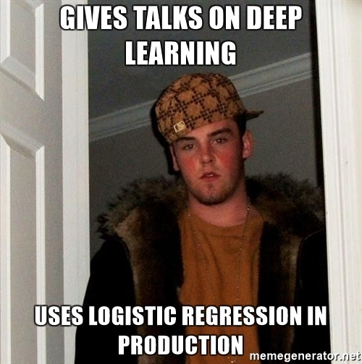
Notebooks

